Slide 1
Formal Methods in Software Engineering

Slide 2
Recapping…..
What is Logic? In computer science, the aim of the logic is to develop a language that models a situation, in which, it can reason formally to realize the desired objective.
What is Reasoning? Reasoning is a process of using existing knowledge or observations to make predictions or draw conclusions.
Due to basic techniques of logical formalisms, formal methods were born.
Formal methods are used in the industry with their specification languages, theorem proving, and model checking

Slide 3
What is Propositional Logic?
Propositional Logic (PL) is a formal language, which is often used in behavior analysis of computing systems.
PL is based on mathematical modelling that can be used to perform reasoning about the truthfulness or falsehood of logical expressions.
The core idea of propositional logic is to develop a language to model the situation in a manner where reasoning can be performed formally to express properties of a system.

Slide 4
Why Propositional Logic?
Most of modern formal specifications and proofs are performed with the use of propositional logic and predicate logic.
Propositional logic is a useful tool for modelling and reasoning in diverse application domains, especially in digital circuits.

Slide 5
Atomic proposition
Propositional logic is based on propositions and propositional formulas, which are written in a propositional language.
Proposition: A declarative sentence that may either be true or false.
Propositions / sentences express the atomic concepts about the world.
Propositional Variables: Propositions / sentences are represented by propositional variables such p, q, r, … For example; p: The sun is shining

Slide 6
Atomic proposition
True: The proposition that is always true is represented by T (or 1)
False: The proposition that is always false is represented by F (or 0)

Slide 7
Atomic proposition
Examples:
  The sun is shining ---- True or False
  It is a fall season ---- True or False
  Islamabad is the capital of Pakistan ---- True
  0 + 1 = 1---- True
  0 + 1 = 2---- False
Example of non-propositions
  Pease listen lecture carefully!
  What is your name?
  x + 1 = 2

Slide 8
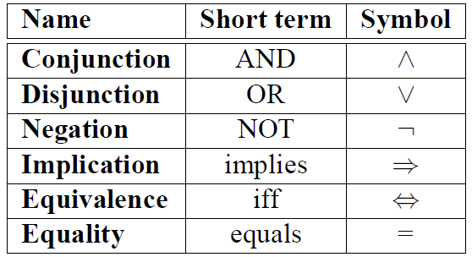
Compound Proposition
Compound proposition are constructed from simple proposition
Two or more propositions are joined using logical connectives
In formal methods, the natural language is scan for propositions. Each proposition (either True or false) will be translated into an expression usually joined using operators.

Slide 9
Translating English sentences to statement in propositional logic
Identify atomic propositions and represent using propositional variables.
Determine appropriate logical connectives
Example;
“If time is 8:00-9:30 am and room CS003 is occupied, then Formal method class is going on.”
p: time is 8:00-9:30 am
q: room CS003 is occupied.
r: Formal method class is going on.
If p and q then r. ➔ p^q → r

Slide 10
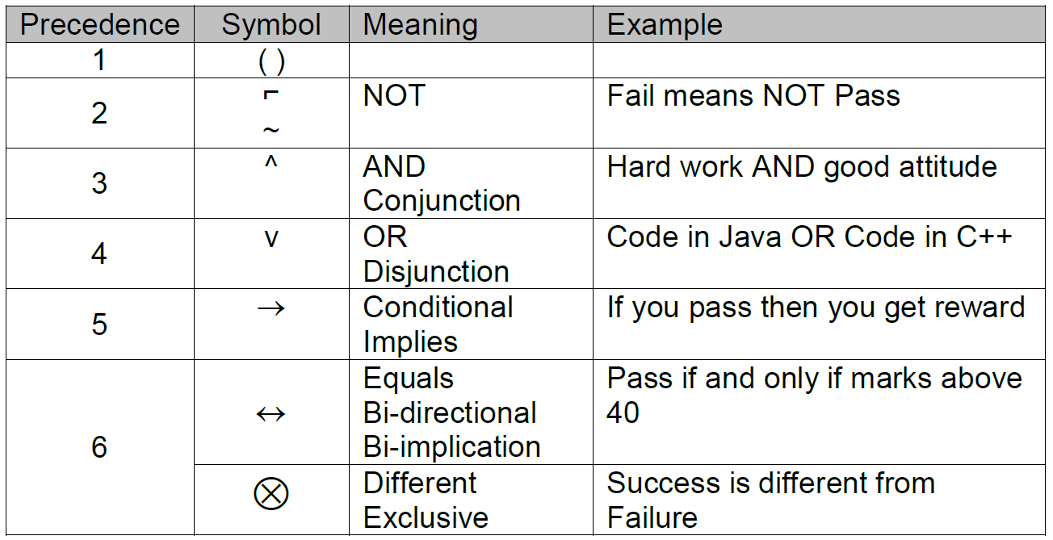
Precedence of logical Connectives in PL

Slide 11
Negation
Proposition: A = It is raining.
Possible value: true or false therefore in a truth table.
Proposition: ⌐A = It is not raining or Not (It is raining).
Possible value: true or false therefore in a truth table.
(A) It is raining
T
F
A | Results (⌐A)
T | F
F | T

Slide 12
Disjunction
The disjunction of propositions p and q is denoted by p ∨ q
p | q | pvq
T | T | T
T | F | T
F | T | T
F | F | F

Slide 13
Disjunction Example
(P v Q) v R

Slide 14
Conjunction
The conjunction of propositions p and q is denoted by p ^ q
p | q | p^q
T | T | T
T | F | F
F | T | F
F | F | F

Slide 15
Conjunction Example
P v (Q ^ R)

Slide 16
Implication
If p and q are propositions, then p → q is a conditional statement or implication which is read as “if p, then q” and has this truth table:
p | q | P → q
T | T | T
T | F | F
F | T | T
F | F | T

Slide 17
Implication
In p → q, p is the hypothesis (antecedent) and q is the conclusion (or consequence)
Implication can be expressed by disjunction and negation:
p → q ≡ ¬p ∨ q
In p → q there does not need to be any connection between the antecedent or the consequent. The meaning depends only on the truth values of p and q.

Slide 18
Implication Example
p → (q → r)

Slide 19
Bi-implication / equivalence
If p and q are propositions, then bi-implication proposition p ↔ q has this truth table
p ↔ q also reads as:
  p if and only if q
  p iff q.
p | q | P ↔ q
T | T | T
T | F | F
F | T | F
F | F | T

Slide 20
Equivalence Example
(p → q) ^ (q → p)

Slide 21
Tautology and Contradiction
Tautology
  if it is always true.
  When all results in the truth table are true
  Example: p ∨ ¬p.
Contradiction /Un-satisfiability
  if it always false.
  When all results in the truth table are false
  Example: p ∧ ¬p.

Slide 22
Satisfiability
A formula is satisfiable if it holds under some or all assignments, which means the truth values of conclusion, some values are true and some values are false.
It may be possible that all values are true.
p | q | p → q | p^(p → q) | p^(p → q) →q
T | T
T | F
F | T
F | F

Slide 23
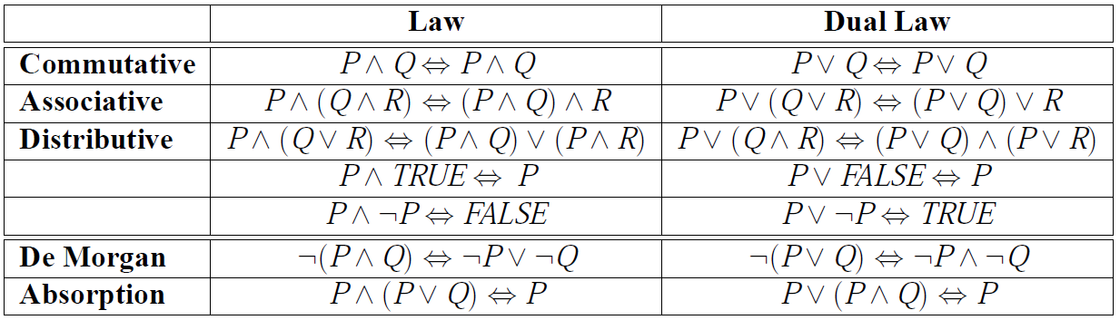
Laws in Propositional Logic

Slide 24
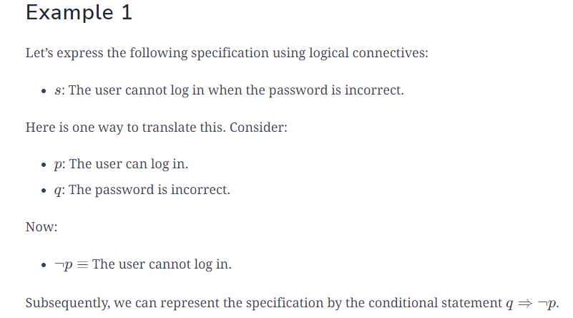

Slide 25
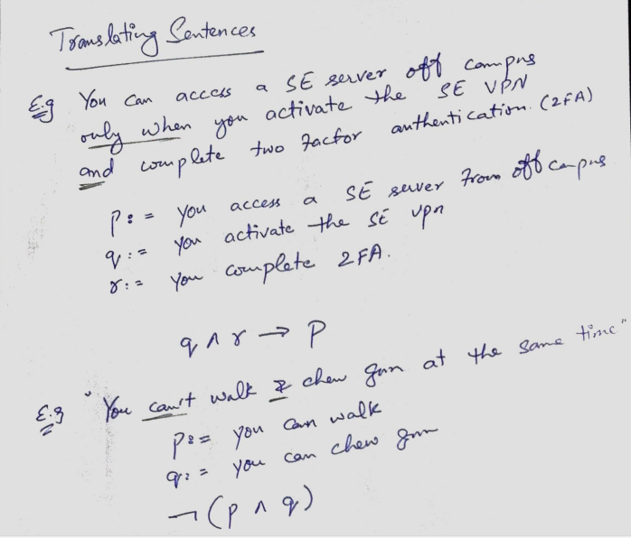

Slide 26
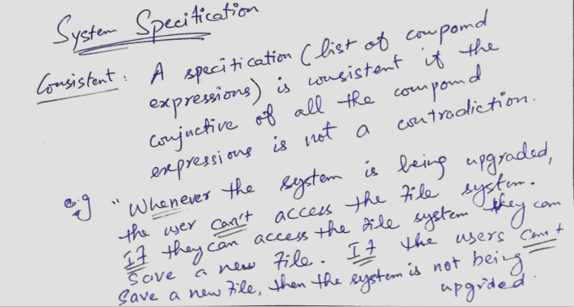

Slide 27
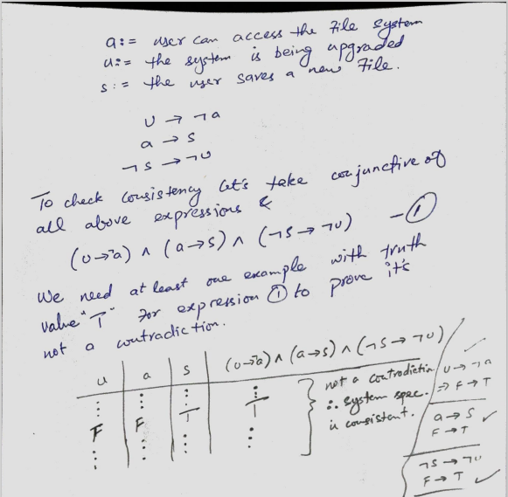

Slide 28
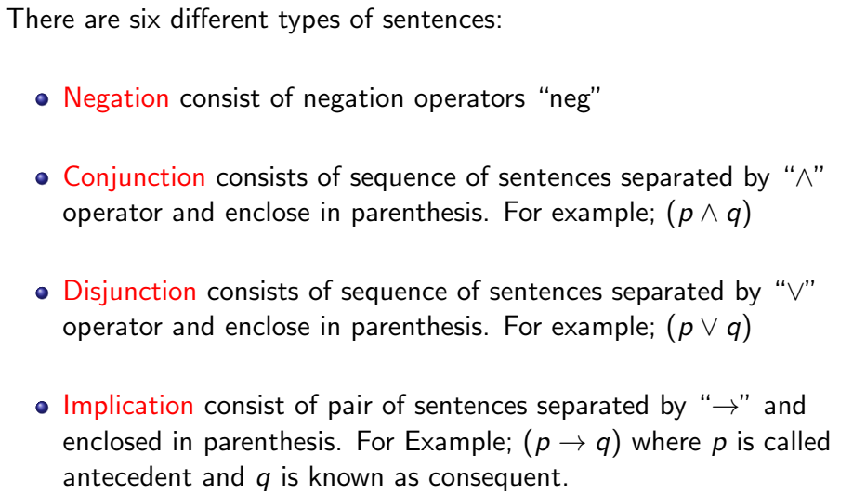
Syntax of Propositional Logic

Slide 29
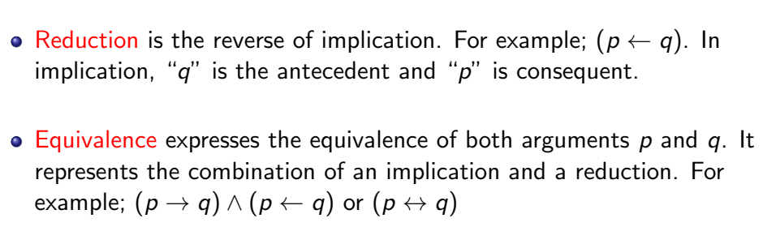
Syntax of Propositional Logic

Slide 30
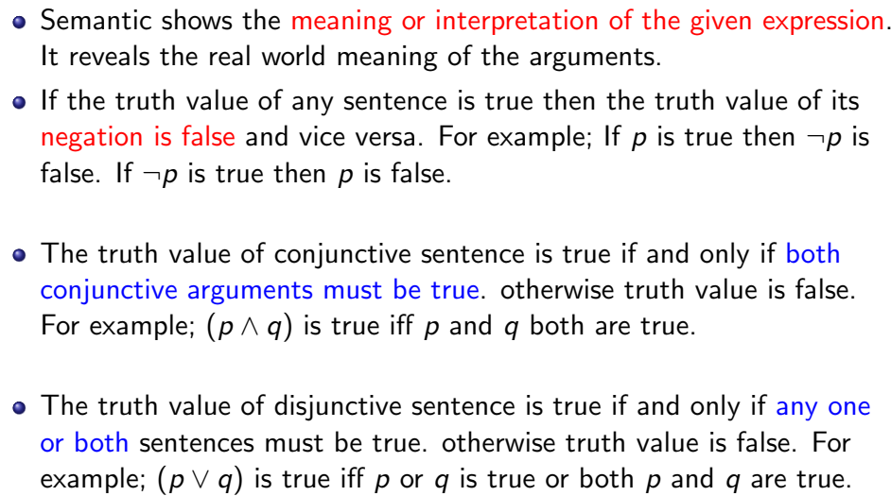
Semantics of Propositional Logic

Slide 31
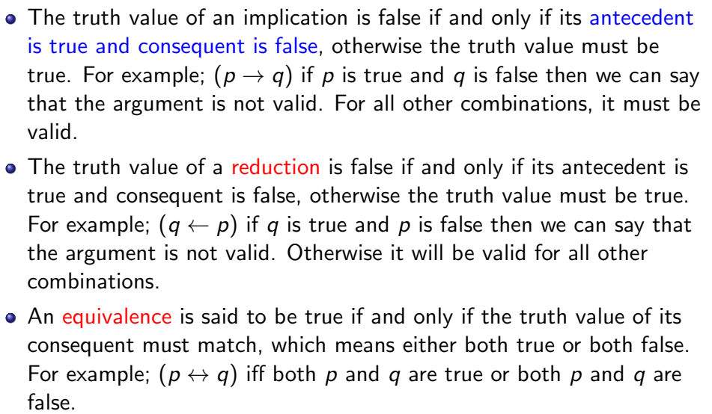
Semantics of Propositional Logic

Slide 32
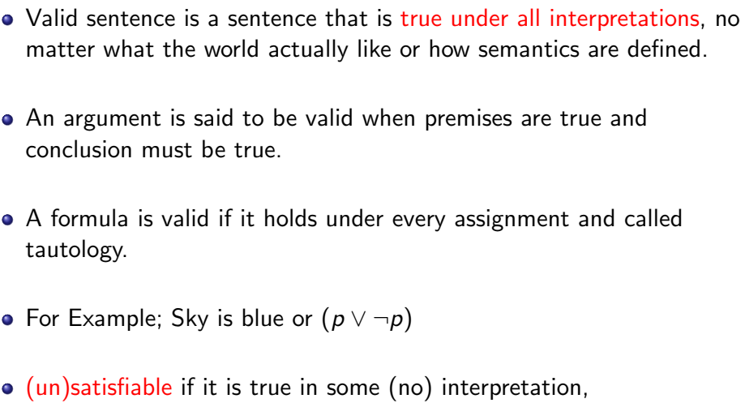
Validity in Propositional Logic

Slide 33
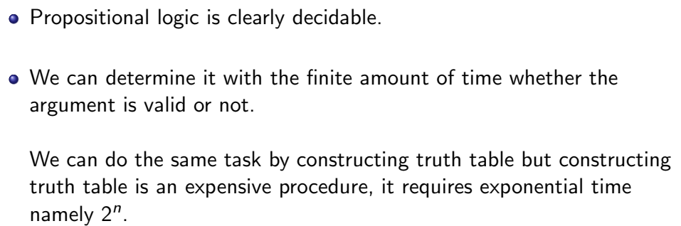
Decidability in Propositional Logic

